Slide 1
Models
Ruby On Rails

Slide 2
1. What is Active Record?
1.1 Active Record…
Is the layer of the system responsible for representing business data and logic
Facilitates the creation and use of business objects whose data requires persistent storage to a database.
Is an implementation of the Active Record pattern which itself is a description of an Object Relational Mapping system

Slide 3
1.2 Object Relational Mapping…
Is a technique that connects the rich objects of an application to tables in a relational database management system
It allows an application to easily store and retrieve properties and relationships of objects from database without writing SQL statements directly and with less overall database access code.

Slide 4
2. Active Record as an ORM Framework
Active Record gives us several mechanisms, the most important being the ability to:
Represent models and their data.
Represent associations between these models.
Represent inheritance hierarchies through related models.
Validate models before they get persisted to the database.
Perform database operations in an object-oriented fashion.

Slide 5
3. Convention over Configuration in Active Record
The idea is that :
if you configure your applications in the very same way most of the time then this should be the default way.
Thus, explicit configuration would be needed only in those cases where you can't follow the standard convention.

Slide 6
3.1 Naming Conventions
By default, Active Record uses some naming conventions to find out how the mapping between models and database tables should be created.
It pluralize the class names to find the respective database table. So, for a class Book, you should have a database table called books
When using class names composed of two or more words,
Examples:
Database Table - Plural with underscores separating words (e.g., book_clubs).
Model Class - Singular with the first letter of each word capitalized (e.g., BookClub).
the table name must contain the words separated by underscores
the model class name should follow the Ruby conventions, using the CamelCase form

Slide 7
3.2 Schema Conventions
Active Record uses naming conventions for the columns in database tables, depending on the purpose of these columns.
Foreign keys - These fields should be named following the pattern singularized_table_name_id (e.g., item_id, order_id). These are the fields that Active Record will look for when you create associations between your models.
Primary keys - By default, Active Record will use an integer column named id as the table's primary key. When using Active Record Migrations to create your tables, this column will be automatically created.

Slide 8
4. Creating Active Record Models
It is very easy to create Active Record models. All you have to do is to subclass the ActiveRecord::Base class and you're good to go:
This will create a Product model, mapped to a products table at the database
class Product < ActiveRecord::Base
end

Slide 9
5. CRUD: Reading and Writing Data
CRUD is an acronym for the four verbs we use to operate on data:
Create
Read
Update
Delete
Active Record automatically creates methods to allow an application to read and manipulate data stored within its tables

Slide 10
5.1 Create
Active Record objects can be created from a hash, a block or have their attributes manually set after creation.
￼
For example,
Given a model User with attributes of name and occupation, the create method call will create and save a new record into the database
user = User.create(name: "David", occupation: "Code Artist")

Slide 11
5.2 Read
Active Record provides a rich API for accessing data within a database. Below are a few examples of different data access methods provided by Active Record
You can learn more about querying an Active Record model in the Active Record Query Interface guide
# return a collection with all users
users = User.all
# return the first user named David
david = User.find_by(name: 'David')
# return the first user
user = User.first
# find all users named David who are Code Artists and sort by created_at in reverse chronological order
users = User.where(name: 'David', occupation: 'Code Artist').order('created_at DESC')

Slide 12
5.3 Update
Once an Active Record object has been retrieved, its attributes can be modified and it can be saved to the database.
A shorthand for this is to use a hash mapping attribute names to the desired value, like so:
This is most useful when updating several attributes at once. If, on the other hand, you'd like to update several records in bulk, you may find the update_all class method useful:
user = User.find_by(name: 'David')
user.name = 'Dave'
user.save
user = User.find_by(name: 'David')
user.update(name: 'Dave')
User.update_all "max_login_attempts = 3, must_change_password = 'true'"

Slide 13
5.4 Delete
Likewise, once retrieved an Active Record object can be destroyed which removes it from the database.
user = User.find_by(name: 'David')
user.destroy

Slide 14
6. Validations
Active Record allows us..
to validate the state of a model before it gets written into the database.
There are several methods that we can use to check our models and validate that an attribute value is not empty, is unique and not already in the database, follows a specific format and many more.￼
Validation is a very important issue to consider when persisting to the database,
so the methods save and update take it into account when running
they return false when validation fails and they didn't actually perform any operation on the database

Slide 15
Here's an example of a very simple validation:
As you can see, our validation lets us know that our Person is not valid without a name attribute. The second Person will not be persisted to the database.
class Person < ActiveRecord::Base
validates :name, presence: true
end
Person.create(name: "John Doe").valid? # => true
Person.create(name: nil).valid? # => false

Slide 16
7. Callbacks
Active Record callbacks allow us
to attach code to certain events in the life-cycle of your models.
it enables us to add behavior to our models by transparently executing code when those events occur, like when you create a new record, update it, destroy it and so on
Here is a list with all the available Active Record callbacks
Creating an Object
before_validation
after_validation
before_save
around_save
before_create
around_create
after_create
after_save
after_commit/after_rollback
Updating an Object
before_validation
after_validation
before_save
around_save
before_update
around_update
after_update
after_save
after_commit/after_rollback
Destroying an Object
before_destroy
around_destroy
after_destroy
after_commit/after_rollback

Slide 17
8. Migrations
Rails provides
a domain-specific language for managing a database schema called migrations.
Migrations are stored in files which are executed against any database that Active Record supports using rake. Here's a migration that creates a table
class CreatePublications < ActiveRecord::Migration
def change
create_table :publications do |t|
t.string :title
t.text :description
t.references :publication_type
t.integer :publisher_id
t.string :publisher_type
t.boolean :single_issue
t.timestamps null: false
end
add_index :publications, :publication_type_id
end
end

Slide 18
9. Associations
Why Associations?
They make common operations simpler and easier in your code
Example without association:- Consider a simple Rails application that includes a model for customers and a model for orders.
To create a new order we will write-
class Customer < ActiveRecord::Base
end
class Order < ActiveRecord::Base
end
@order = Order.create(order_date: Time.now, customer_id: @customer.id)

Slide 19
Example with association-
To create order we will write –
class Customer < ActiveRecord::Base
has_many :orders, dependent: :destroy
end
class Order < ActiveRecord::Base
belongs_to :customer
end
@order = @customer.orders.create(order_date: Time.now)

Slide 20
9.1 Types of Associations
Six Types of associations-
belongs_to
has_one
has_many
has_many :through
has_one :through
has_and_belongs_to_many

Slide 21
9.1.1 The belongs_to Association
Sets up one-to-one connection with another model
If each order can be assigned to exactly one customer then
The migrations will look like-
class Order < ActiveRecord::Base
belongs_to :customer
end
class CreateOrders < ActiveRecord::Migration
def change
create_table :customers do |t|
t.string :name
t.timestamps null: false
end
create_table :orders do |t|
t.belongs_to :customer, index: true
t.datetime :order_date
t.timestamps null: false
end
end
end

Slide 22
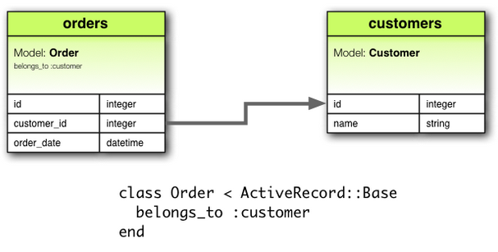
Cntd…

Slide 23
9.1.2 The has_one Association
Sets up one-to-one connection with another model
If each supplier in your application has only one account
The migrations will look like-
class Supplier < ActiveRecord::Base
has_one :account
end
class CreateSuppliers < ActiveRecord::Migration
def change
create_table :suppliers do |t|
t.string :name
t.timestamps null: false
end
create_table :accounts do |t|
t.belongs_to :supplier, index: true
t.string :account_number
t.timestamps null: false
end
end
end

Slide 24
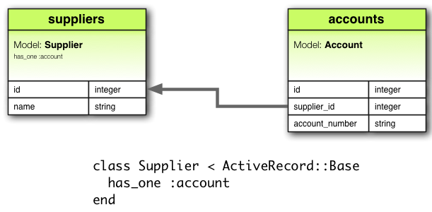

Slide 25
9.1.3 The has_many Association
Sets up many-to-many connection with another model
In an application containing customers and orders, the customer model could be declared like this:
The migrations will look like-
class Customer < ActiveRecord::Base
has_many :orders
end
class CreateCustomers < ActiveRecord::Migration
def change
create_table :customers do |t|
t.string :name
t.timestamps null: false
end
create_table :orders do |t|
t.belongs_to :customer, index:true
t.datetime :order_date
t.timestamps null: false
end
end
end

Slide 26
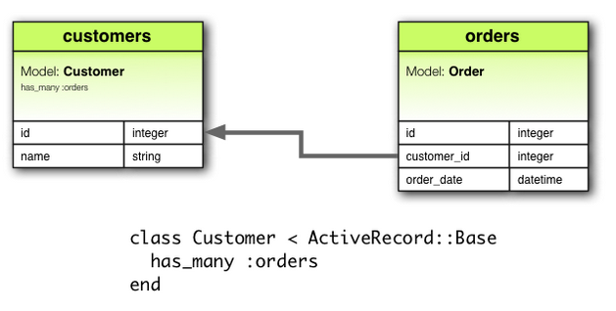

Slide 27
9.1.3 The has_many :through Association
Set up a many-to-many connection with another model using a third model
Consider a medical practice where patients make appointments to see physicians:
class Physician < ActiveRecord::Base
has_many :appointments
has_many :patients, through: :appointments
end
class Appointment < ActiveRecord::Base
belongs_to :physician
belongs_to :patient
end
class Patient < ActiveRecord::Base
has_many :appointments
has_many :physicians, through: :appointments
end

Slide 28
The migration file will look like:
class CreateAppointments < ActiveRecord::Migration
def change
create_table :physicians do |t|
t.string :name
t.timestamps null: false
end
create_table :patients do |t|
t.string :name
t.timestamps null: false
end
create_table :appointments do |t|
t.belongs_to :physician, index: true
t.belongs_to :patient, index: true
t.datetime :appointment_date
t.timestamps null: false
end
end
end

Slide 29
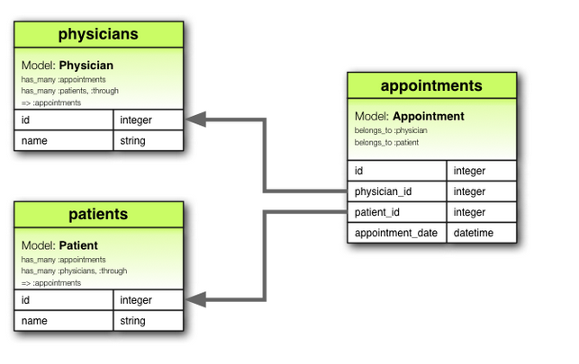

Slide 30
9.1.3 The has_one :through Association
Sets up a one-to-one connection with another model using a third model
If each supplier has one account, and each account is associated with one account history:
class Supplier < ActiveRecord::Base
has_one :account
has_one :account_history, through: :account
end
class Account < ActiveRecord::Base
belongs_to :supplier
has_one :account_history
end
class AccountHistory < ActiveRecord::Base
belongs_to :account
end

Slide 31
The migration file will look like:
class CreateAccountHistories < ActiveRecord::Migration
def change
create_table :suppliers do |t|
t.string :name
t.timestamps null: false
end
create_table :accounts do |t|
t.belongs_to :supplier, index: true
t.string :account_number
t.timestamps null: false
end
create_table :account_histories do |t|
t.belongs_to :account, index: true
t.integer :credit_rating
t.timestamps null: false
end
end
end

Slide 32
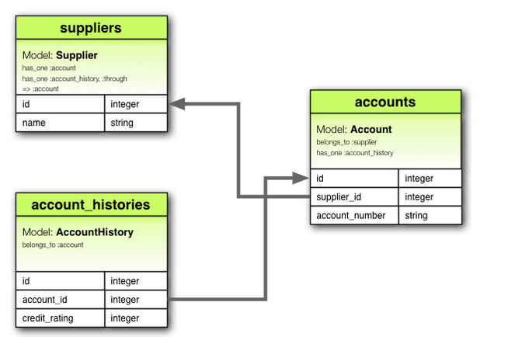

Slide 33
9.1.3 The has_and_belongs_to_many Association
Creates a direct many-to-many connection with another model, with no intervening model
If your application includes assemblies and parts, with each assembly having many parts and each part appearing in many assemblies, you could declare the models this way
class Assembly < ActiveRecord::Base
has_and_belongs_to_many :parts
end
class Part < ActiveRecord::Base
has_and_belongs_to_many :assemblies
end

Slide 34
The migration file will look like:
class CreateAssembliesAndParts < ActiveRecord::Migration
def change
create_table :assemblies do |t|
t.string :name
t.timestamps null: false
end
create_table :parts do |t|
t.string :part_number
t.timestamps null: false
end
create_table :assemblies_parts, id: false do |t|
t.belongs_to :assembly, index: true
t.belongs_to :part, index: true
end
end
end

Slide 35
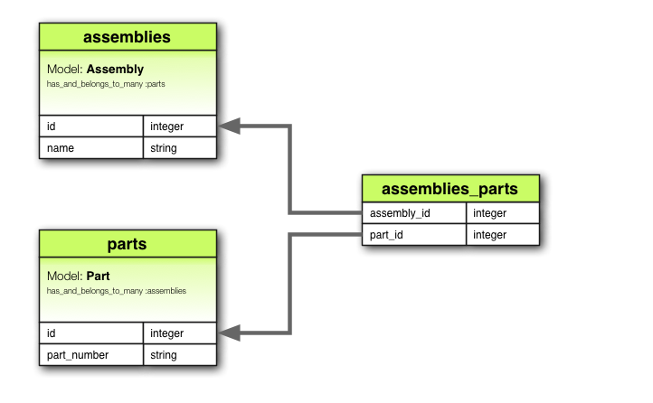

Slide 36
9.1.3 The Polymorphic Associations
Creates a direct many-to-many connection with another model, with no intervening model
You might have a picture model that belongs to either an employee model or a product model
class Picture < ActiveRecord::Base
belongs_to :imageable, polymorphic: true
end
class Employee < ActiveRecord::Base
has_many :pictures, as: :imageable
end
class Product < ActiveRecord::Base
has_many :pictures, as: :imageable
end

Slide 37
The migration file will look like:
class CreatePictures < ActiveRecord::Migration
def change
create_table :pictures do |t|
t.string :name
t.integer :imageable_id
t.string :imageable_type
t.timestamps null: false
end
add_index :pictures, :imageable_id
end
end

Slide 38
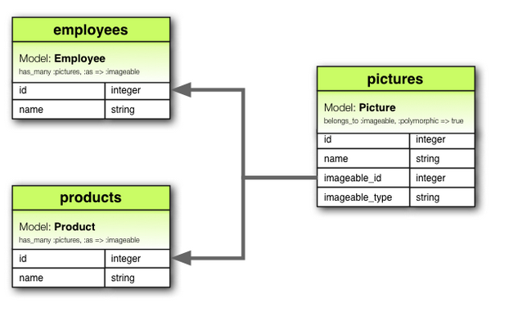

Slide 39
9.1.3 Self Joins
Creates a model that will have association to itself
You may want to store all employees in a single database model, but be able to trace relationships such as between manager and subordinates
class Employee < ActiveRecord::Base
has_many :subordinates, class_name: "Employee",
foreign_key: "manager_id"
belongs_to :manager, class_name: "Employee"
end

Slide 40
Thank You

